Slide 1
Neural Networks
CS 245
CS 245 – Robotics and Machine Learning

Slide 2
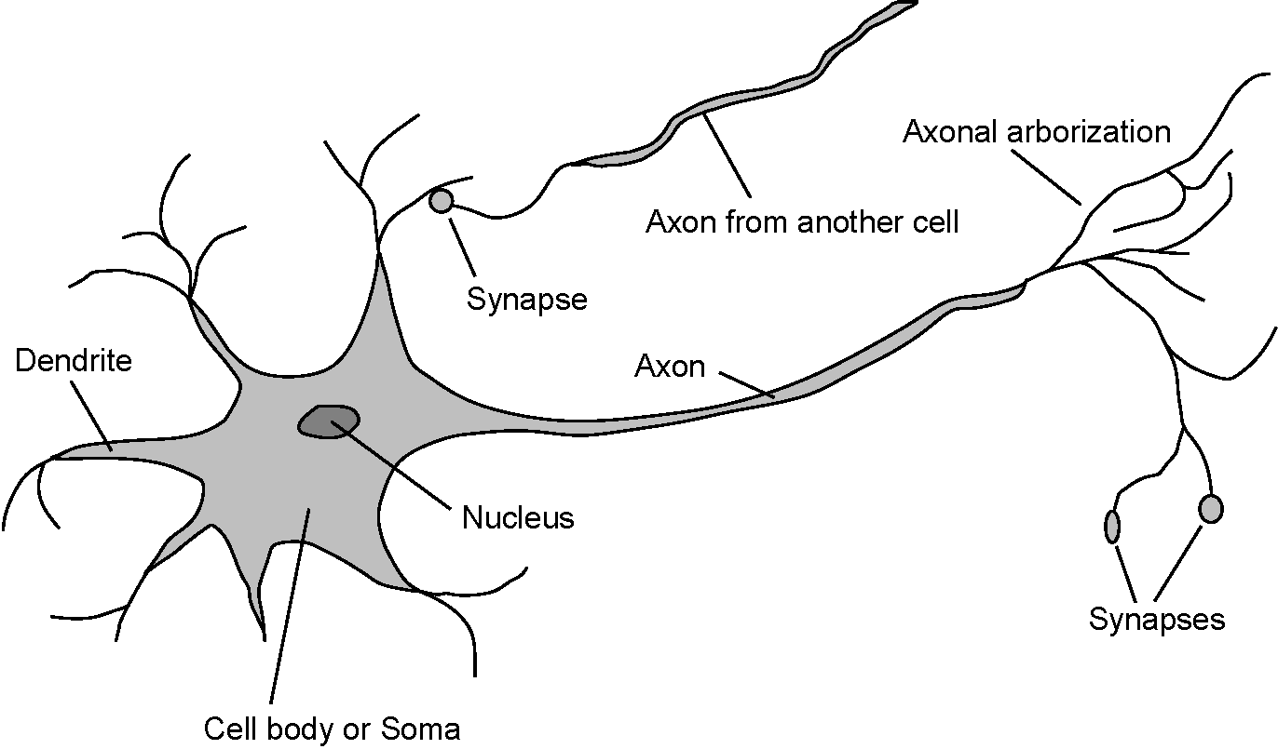
Neural Networks
Neuroscience (1861 – present)
    How do brains process information?
  Study of the nervous system (brain)
  Paul Broca : Speech deficit studies
  Neurons and brain areas
  EEG and fMRI
  Brains cause minds (Searle, 1992)
CS 245 – Robotics and Machine Learning

Slide 3
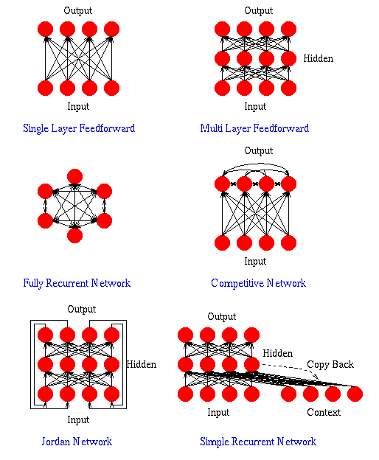
Artificial Neural Networks
An Artificial Neural Network (ANN) is an interconnected assembly of simple processing elements, units or nodes, whose functionality is loosely based on the animal neuron.
The processing ability of the network is stored in the inter-unit connection strengths, or weights, obtained by a process of adaptation to, or learning from, a set of training patterns.
CS 245 – Robotics and Machine Learning

Slide 4
History of Neural Networks
Brief history of events
  1943 (McCulloch and Pitts – model of neurons)
  1949 (Hebb – learning law)
  1954 (Minsky - neural nets)
  1958 (Rosenblatt – perceptron)
  1969 (Minsky – limitations of perceptrons – “AI Winter”)
  1974 (Werbos – backpropagation)
  1977 (Kohonen – associative memory)
  1980 (Grossberg – psychological models)
  1986 (Rumlehart & McClelland – PDP)
CS 245 – Robotics and Machine Learning

Slide 5
Neural Networks
The Structure of a Neuron
  A neuron only “fires” if it’s input signal exceeds a threshold level within a short time period
  Synapses vary in strength
    Good connections allow a large signal
    Slight connections only allow a weak signal
Synapses can be either exhibitory or inhibitory
Artificial Neural Networks
  A model of the way in which the brain performs a particular task or function
    Simplified mathematical model
    Neurons connected together
  Characterised by:
    Connectivity (parallel processing)
    Adaptability (learning)
CS 245 – Robotics and Machine Learning

Slide 6
McCulloch-Pitts Neuron
First mathematical model of the biological neuron
  McCulloch and Pitts (1943)
Most of the models we use today are descended from this
Used a set of “physical assumptions” (1943:118)
McCulloch, W.S. & Pitts, W. (1943). A Logical Calculus of the Ideas Immanent in Neurons Activity. Bulletin of Mathematical Biophysics, vol. 5, pp. 115-133
CS 245 – Robotics and Machine Learning
Notes:
An example of a different type of model is the pulse coded neuron.
See overhead for example from McCulloch and Pitts (1943):
Page 115 (first): description of the nervous system.
Page 118: physical assumptions.

Slide 7
Physical Assumptions
The neuron’s activity is “all-or-none”
  Output is either 1 (all) or 0 (none)
  Based upon the “all-or-none” law of nervous activity
  Allows description of system using propositions
A certain fixed number of synapses must be excited in order to induce an output
  A threshold of activity is required to induce an output of 1
Synaptic activity that is inhibitory prevents output
  Any single inhibitory input ensures an output of 0
The only significant delay is synaptic
  Neurons act synchronously
The structure of the network does not change
  Fixed system that takes input to produce output
CS 245 – Robotics and Machine Learning

Slide 8
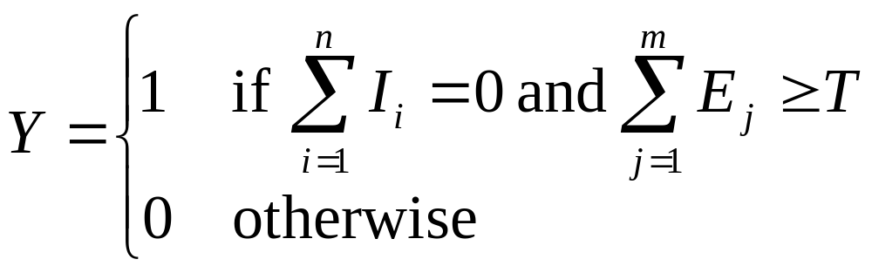
McCulloch-Pitts Neuron
T = Threshold value
E₁
Excitatory Inputs
E₂
E_{m}
I₁
T
Y
Inhibitory Inputs
I₂
I_{n}
Y = Output
CS 245 – Robotics and Machine Learning

Slide 9
McCulloch-Pitts Neuron
With sufficient number of McCulloch-Pitts neurons, correct parameters and synchronous operation:
  In principle, a McCulloch-Pitts network can compute any computable function
  Using these to implement the logic functions was therefore of great interest
  The link between the brain and digital computers?
But, it has no concept of learning
  Operation governed by form of excitatory and inhibitory connections, and threshold
  Assumption that structure does not change
  Structure encodes operation
  Assumption that operation does not change
CS 245 – Robotics and Machine Learning

Slide 10
Elementary Neuron
The McCulloch-Pitts neuron forms the foundation of the modern artificial neuron
Main changes in a modern artificial neuron:
  Each connection is weighted
  Inhibitory connections have negative weights
  Excitatory connections have positive weights
  Activity is calculated using a weighted summation of the input signals
  Threshold may be linear or non-linear
CS 245 – Robotics and Machine Learning

Slide 11
Elementary Neuron
Bias
w_{k0}
x₁
w_{k1}
Output
x₂
w_{k2}
Σ
Input Signals
Φ(.)
y_{k}
Activation Function
Summing Junction
x_{m}
w_{km}
Synaptic Weights
CS 245 – Robotics and Machine Learning
Notes:
Non-linear neuron, taken from Haykin (1999:11)

Slide 12
Bias
w=____?
w1=____?
x₁
Σ
Threshold = 1.0
Output
w2=____?
x₂
CS 245 – Robotics and Machine Learning

Slide 13
Elementary Neuron
Inputs x₁, x₂, …, x_{m}
  Encodes input to neural network
Bias w_{k0}
  Encodes threshold value within weighted summation
  Corresponds with constant input x₀ = 1
    But its weight could have any value
Synaptic / connection weights
  Strength of connection from input to neuron
  Negative is inhibitory
  Positive is excitatory
CS 245 – Robotics and Machine Learning

Slide 14
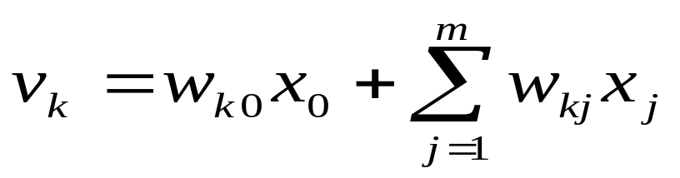
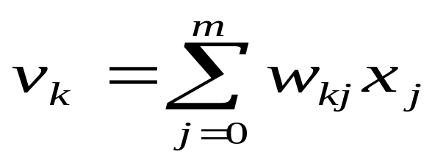
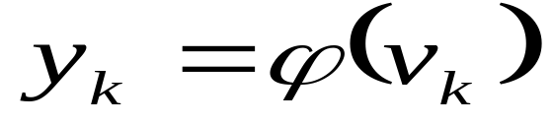
Elementary Neuron
Summing junction
  Weighted summation
  Taking into account bias
Activation function
  Uses weighted summation to determine whether the neuron should fire: threshold
Output
  Output from activation function
CS 245 – Robotics and Machine Learning

Slide 15
Activation Functions
Hard threshold
  Binary: outputs either 0 or 1
  Bipolar: outputs either –1 or 1
  Heaviside / Step / Signum or Piecewise-linear function
Non-linear threshold
  Outputs a range of values
  Binary: outputs a value within [0,1]
  Bipolar: outputs a value within [-1,1]
  Logistic Sigmoid or Hyperbolic Tangent function
CS 245 – Robotics and Machine Learning

Slide 16
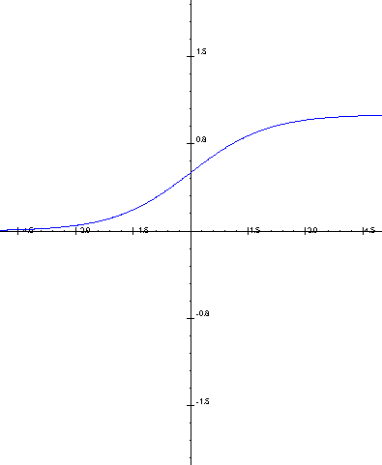
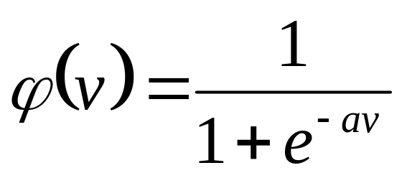
Logistic Sigmoid
Binary
CS 245 – Robotics and Machine Learning

Slide 17
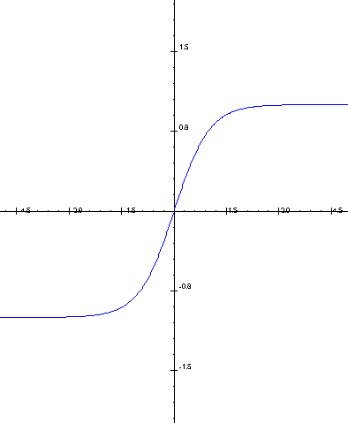
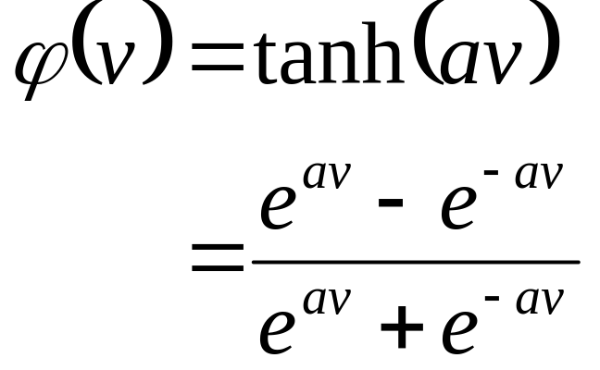
Hyperbolic Tangent
Bipolar
CS 245 – Robotics and Machine Learning

Slide 18
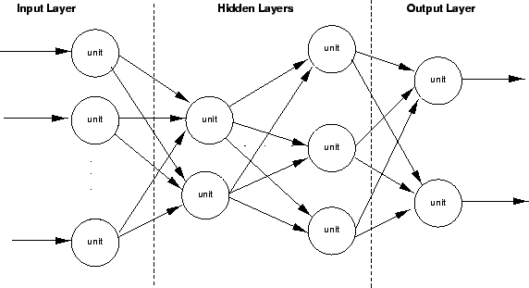
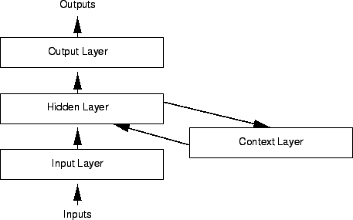
Neural Networks
Two basic neural network architectures:
  Feedforward NN
    Data flow is in one direction (input-hidden-output)
    Weighted Connections
  Recurrent (Feedback) NN
    Data flows in both directions
    Weighted Connections

Slide 19
Connectivity
NNs can have hidden layers
  A hidden layer is not directly connected to the layer of input neurons (input signals) nor to the layer of output neurons
x₁
Output
y₁
x₂
Input Signals
y₂
x_{m}
Layer of Output Neurons
Layer of Input Neurons
Layer of Hidden Neurons
CS 245 – Robotics and Machine Learning
Notes:
Non-linear neuron, taken from Haykin (1999:22)

Slide 20
Neural Network Taxonomies
Training
Supervised Training
Unsupervised Training
Perceptron/
Multi-Layer
Perceptron
Auto-
associative
Kohonen
Self-Organising
Map
ART
Hopfield
Radial
Basis
Function
CS 245 – Robotics and Machine Learning

Slide 21
Learning
‘The action of receiving instruction or acquiring knowledge’
‘A process which leads to the modification of behaviour or the acquisition of new abilities or responses, and which is additional to natural development by growth or maturation’
Simpson, J.A. & Weiner, E.S.C. (Ed) (1989). Oxford English Dictionary, 2nd. Oxford, UK: Clarendon Press. Online: http://www.oed.com
CS 245 – Robotics and Machine Learning

Slide 22
Learning
Neural Networks learn through training
  Once a NN is constructed, it is trained on a training data set
    These examples provide the knowledge to the network
  Training accomplishes:
    Adjustment of the synaptic weights to correctly solve the problems from the training set
    Adjustment is typically based on some sort of feedback (reinforcement learning)
      Challenge is that one synaptic adjustment can render the rest of the network inaccurate
      Therefore, synaptic adjustments must be considered globally
  Once trained, the NN is tested on other examples
    To evaluate its accuracy
  Once tested, the network may be used for real-world tasks
    E.g., classification (artificial nose, insurance decisions)
    Often used for problems that are not solvable with “other techniques”
CS 245 – Robotics and Machine Learning

Slide 23
Learning Concepts
Inductive learning
  Learning from examples
  Concept learning: induce concepts from examples
    Decision trees can also be used here
  Explanation-based learning: explain how an example fits domain theory – ignores noise, selects attributes
  Learn from experience
    Through examples, analogy or discovery
Adaptation
  Changes in response to interaction
Generalisation
  To use experience to form a response to novel situations
CS 245 – Robotics and Machine Learning
Notes:
Concept learning: decision trees and ID3

Slide 24
Learning Concepts
Similarity-based learning
  Generalisation is a function of similarities in examples
  Recognising patterns through similarity
Evolutionary/genetic learning
  Shaping a population of individual solutions through survival of the fittest
  Emergent learning
  Learning through social interaction: game of life
CS 245 – Robotics and Machine Learning

Slide 25
Learning Concepts
Supervised learning
  Training examples with a known classification from a teacher
Reinforcement learning
  Similar to supervised learning, but critic-based: good/bad result for series of examples
Unsupervised learning
  No pre-classification of training examples
  Competitive learning: learning through competition on training examples
CS 245 – Robotics and Machine Learning

Slide 26
Why Learning?
Luger:
  ‘Intelligent agents must be able to change through the course of their interactions with the world’
Callan:
  ‘A machine or software tool would not be viewed as intelligent if it could not adapt to changes in its environment’
Luger, G.F. (2002). Artificial Intelligence: Structures & Strategies for Complex Problem Solving. 4th Edition. London, UK: Addison-Wesley.
Callan, R. (2003). Artificial Intelligence, Basingstoke, UK: Palgrave MacMillan.
CS 245 – Robotics and Machine Learning

Slide 27
Applications of Neural Networks
Used in Applications where
  Data is available
  Complex relationships exist in data
  Data is low-level
Seldom used where:
  Mission critical applications where explanation of operation is required.
      military
      medical
      aerospace
  Techniques to partially solve this exist
CS 245 – Robotics and Machine Learning

Slide 28
Data specification and collection
Is there enough data available? If there is too little NN not appropriate
As a very crude 'guide' to amount of records required you need 5 times as many data records as there are weights between inputs and hidden. e.g. given 6 inputs, say 6 hidden units = 36 weights giving 180 data records
  This is a crude estimate (could probably do it with less data records) but indicates that if you have (say) 10 records, a NN is not appropriate!
CS 245 – Robotics and Machine Learning

Slide 29
Overfitting
A primary problem to consider when building network is how to prevent overfitting
Overfitting : when the network performs well on the training set, but poorly on the test set
  Network is becoming too well fitted to the training data
  To alleviate the problem:
    Consider two networks (A and B) that have been trained to categorize two types of widget, X and Y
    Then a test example (Z) is presented, that the network has not seen before
CS 245 – Robotics and Machine Learning

Slide 30
Learning
How does the model neuron learn?
McCulloch-Pitts has no concept of learning:
  Operation of neurons is encoded by the inhibitory and excitatory connections, together with the threshold
  No structural changes allowed
Learning in the model neuron is achieved through modifying the connection weights only (including the bias)
CS 245 – Robotics and Machine Learning

Slide 31
Biologically Inspired Learning
Hebb’s neurophysiological postulate:
  When the two inputs to a neuron are active, the connection strength is increased
Kohonen’s Self-organising Map (SOM)
  Modelling topographic maps thought to be used in the brain
  Inspired from Hebbian learning
  Both examples of unsupervised learning
    Learning through input signals only
    May be a competitive process
CS 245 – Robotics and Machine Learning

Slide 32
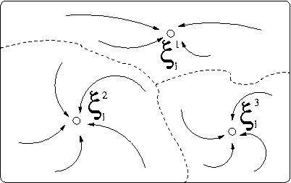
Associative Memory
The basic problem :
Store a set of n patterns {p₁, p₂, …, p_{n}} in such a way that when presented with a new pattern p_{i}, the network responds by producing whichever one of the stored patterns it most closely resembles

Slide 33
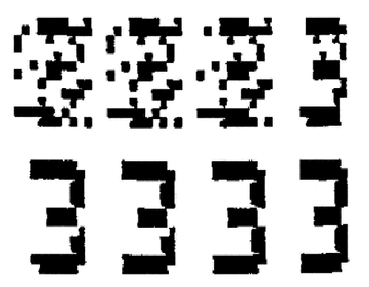
Example of Associative Memory
Reconstructed patterns for noisy “3” inputs

Slide 34
Hopfield Neural Networks
Represent Associative Memory
  For example, the olfactory (nose) system is associative
  Other memory in humans is also associative
  For example:
    someone may say something, like the name of a celebrity, and we immediately recall a chain of events or some experience related to the celebrity - we may have seen them on TV recently for example.
    Or, we may see a picture of a place visited in our childhood and the image recalls memories of the time. The sense of smell (olfaction) is known to be especially evocative in this way.
  Usually implemented as Hopfield Nets
    Bowl and ball bearing analogy
CS 245 – Robotics and Machine Learning

Slide 35
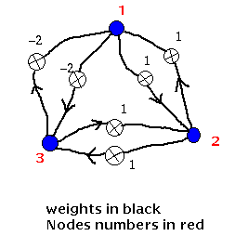
Hopfield Neural Networks
Every node is connected to every other node (but not to itself) and the connection strengths or weights are symmetric in that the weight from node i to node j is the same as that from node j to node i.
Notice that the flow of information in this
net is not in a single direction as it has
been in the nets dealt with so far. It is
possible for information to flow from a
node back to itself via other nodes.
  That is, there is feedback in the network and so
  They are known as feedback or recurrent nets
  as opposed to feedforward nets which are easier to
  implement (Backpropagation algorithm).
CS 245 – Robotics and Machine Learning

Slide 36
Neural Networks
Neural Networks
  Advantages
    learn from data (induction)
    fast response time (operation)
    model non-linear and complex relationships
    noise tolerant
  Disadvantages
    may take long training periods
    may not converge to a good solution
    random initial conditions
    “Black box” technique, internal structure difficult to comprehend
CS 245 – Robotics and Machine Learning

